Slide 1
Pneumatic Shoulder Exosuit
Lit Review
Summer 2025

Slide 2
Paper Summary - Control Overview
Paper | Exo Type | Motion Intention Detection | Torque Profile Generation | Low Level Controller
Harvard (Science Robotics 2024) [1] | Shoulder | IMU based - inflates/deflates if angle and angular velocity exceed threshold | Target inflated hard-coded (adapted for each subject during calibration) | Bang-bang
Cornell (RAL 2016) [2] | Finger | Tracking changes in EMG | Curvature based - try to adjust pressure to match desired curvature from high-level controller | State machine controlling valve open/close times
Stanford (ICRA 2017) [3] | Shoulder | None | Target pressure hard-coded - tried different pressures in increments of 7 kPa | No information
Newcastle (RAL 2021) [4] | N/A - three actuators tested but none in exo form | None | Target pressure hard-coded (step functions used to test low-level controllers) | 1. PI with anti-windup 2. Bang-bang with hysteresis
BioRobotics Institute Italy (TMRB 2025) [5] | Shoulder | None | Target pressure hard-coded (70 kPa for all subjects) | Bang-Bang with hysteresis
National University of Singapore (BioRob 2016) [6] | Shoulder | None | Target pressure hard-coded | PWM/No information
Technical University Darmstadt (Nature Scientific Reports 2021) [7] | Elbow | None | Target pressure hard-coded (130 kPa for all subjects) | Manually controlled by operator

Slide 3
Paper Summary - Control Overview
Paper | Exo Type | Motion Intention Detection | Continuous Torque/Angle during Human Tests | Adaptable to change in load
Harvard (Science Robotics 2024) [1] | Shoulder | ✅ (rules-based) | ❌ | ❌
Cornell (RAL 2016) [2] | Finger | ✅ (EMG tracker) | ✅(based on curvature) | ❌
Stanford (ICRA 2017) [3] | Shoulder | ❌ | ❌ | ❌
Newcastle (RAL 2021) [4] | N/A - three actuators tested but none in exo form | ❌ | ❌ | ❌
BioRobotics Institute Italy (TMRB 2025) [5] | Shoulder | ❌ | ❌ | ❌
National University of Singapore (BioRob 2016) [6] | Shoulder | ❌ | ❌ | ❌
Technical University Darmstadt (Nature Scientific Reports 2021) [7] | Elbow | ❌ | ❌ | ❌
Harvard ALS (Science Translational Medicine, 2023) | Shoulder | ✅ (rules-based) | ✅ (gravity comp.) | ❌
Harvard 3 (Nature Communications, 2025) [13] | Shoulder | ✅ (Fully 2 layer connected NN) | ✅(updates in 5 degree increments) | ❌

Slide 4
Paper Summary - Speed and Testing
Paper | Exo Type | Cycle/Inflation Speed | Assessments | User Activities
Harvard (Science Robotics 2024) [1] | Shoulder | 6 cycles/minute (0 to 70 kPa) | EMG, mis-inflation/deflation rate, user satisfaction | Overhead assembly (static inflation and dynamic)
Cornell (RAL 2016) [2] | Finger | Rise time 150ms (less air needed for finger actuator) | EMG, curvature error | Button press
Stanford (ICRA 2017) [3] | Shoulder | 3 seconds rise time to reach 27.5 kPa | EMG, range of motion | Isometric and dynamic reaching tasks
Newcastle (RAL 2021) [4] | N/A - three actuators tested but none in exo form | N/A since actuators are not exo-sized / Variable based on control type | Pressure error and rise time | N/A
BioRobotics Institute Italy (TMRB 2025) [5] | Shoulder | ~5 to inflate, ~3.5 seconds to deflate (0 to 70 kPa) | EMG, range of motion | Reaching, lift and hold (healthy and SCI patients)
National University of Singapore (BioRob 2016) [6] | Shoulder | No information | Pressure-angle relationship | None - tested abduction without human activation
Technical University Darmstadt (Nature Scientific Reports 2021) [7] | Elbow | With pressurized air tank: ~2 seconds / cycle No tank: ~15 seconds/cycle | EMG, net metabolic Rate, user comfort | Holding, carrying various weights No dynamic tasks requiring inflation/deflation

Slide 5
Motion Intention Detection
For pneumatic exos, most make no attempt to do motion intention detection
Harvard paper uses IMU to classify inflation and deflation events
If angle and angular velocity detected by IMU reach a target threshold, this triggers inflation/deflation of the device
Exo only has two states (inflated or deflated) with pressure of inflated state calibrated for each participant
TNR: 96.1%, TPR: 91.3%
Cornell paper (finger exo) uses EMG activity to detect determine desired curvature of device
More complex intention detection has been used in other applications
Harvard intention detection paper [10] uses DCNN and activity classification to predict joint angles (6.5° error) (note: no exo used here)
Nanyang paper [11] uses a variety of ML algorithms and finds that RNN/LSTM perform the best (note: no exo used here)
Review papers also cite EMGs, external inputs (button clicking, verbal input), eye-tracking, etc. as alternative intention detection methods
Would ideally like to stick with just IMU for simplicity/cost/intuitiveness
Gap in research: Learning based IMU intention detection hasn’t been used on pneumatic exos, and can try different types of NN (transformers?) to improve performance that haven’t been used on any upper limb exos

Slide 6
Torque Profile Generation
All shoulder/elbow pneumatic exoskeletons had only one target pressure for the inflated state
Either one pressure for all subjects or calibrated for each subject (Harvard)
No ability to adjust the support for dynamic changes, such as change in desired arm position or picking up an object
Since pressure is preset, exo support only tested at one angle
Only Cornell paper (finger exo) was able to handle different levels of inflation (based on desired curvature)
Gap in research: Create controller that adapts pressure continuously based on desired arm position and can handle picking up/putting down objects

Slide 7
Low Level Controller
Most pneumatic exos use bang-bang control with hysteresis/tolerance band
From preliminary testing, this makes sense (especially for big changes in pressure) because it minimizes the time to change the pressure, and small overshoots are not a concern
Current version of our controller essentially acts as bang-bang when far from target pressure, because PWM gain maxes out (see PWM gain testing results)
Gap in Research: Can try more sophisticated systems for low level control, particularly for fine-tuning when close to desired pressure.

Slide 8
Next Steps
Most pneumatic exoskeletons have no or very simple intention prediction. We could try to improve this using ML techniques.
Use IMU to keep equipment simple and avoid issues with EMG (supported by [11] that IMU is sufficient for motion prediction)
The pneumatic exoskeletons tested were generally only tested at one inflated position/pressure per subject.
Creating a continuous controller would improve versatility
Creating a controller that is able to adjust when user picks up an object (i.e. maintain position by increasing pressure when load increases) would improve performance

Slide 9
Paper Details
Papers 1-7 are about pneumatic exoskeletons
Papers 8 and 9 are review papers on the state of upper-limb exoskeletons and intention detection controllers
Papers 10-12 are about intention/motion detection algorithms but do not involve pneumatic exos

Slide 10
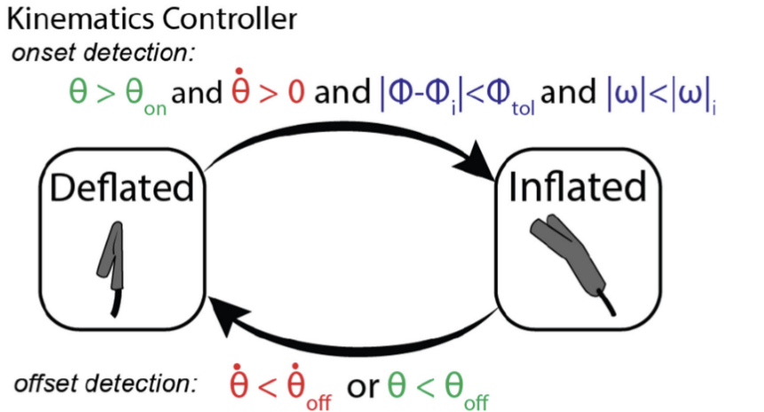
Harvard (Science Robotics 2024) [1]
Title: A portable inflatable soft wearable robot to assist the shoulder during industrial work
Link
Description: Inflatable exoskeleton for shoulder support, tested on users in laboratory and on industrial workers
Controller:
IMU-based
Inflates if arm angle exceeds threshold
Deflates if arm angle and velocity exceed threshold
During circuit task (alternating between needing assistance and not): TNR: 96.1%, TPR: 91.3%
Note: this seems beatable, especially with an NN
Bang-bang controller used to change air pressure
Pressure set point set by subject preference (no math based on body weight/limb length)
Inflation time/speed:
“Can cycle on and off six times per minute”
Goal: “be able to assist quickly (within 2 s of an individual beginning a task)”
No response curves shown
Noted that users found the exo less useful for dynamic tasks

Slide 11
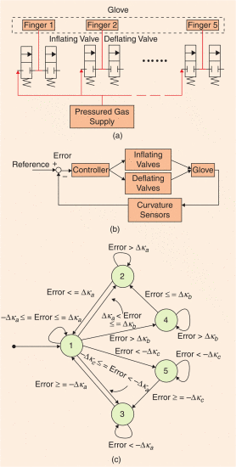
Cornell (RAL 2016) [2]
Title: A Helping Hand: Soft Orthosis with Integrated Optical Strain Sensors and EMG Control
Link
Description: Inflatable soft hand exo with individual actuation for each finger
Controller:
Inflates/deflates until within tolerance range of desired curvature (as determined by Optical-Fiber Sensors)
Flow slows when approaching deadband to prevent overshoot
Used average EMG signal as input for curvature
A bit confusing here, as you may want the curvature to remain high while the user can rely on the exo and relax their muscles? I think this is just proof of concept
Inflation time/speed:
In best controller, rise time about 150ms
Note that the finger actuators are much smaller than the shoulder ones, so much less air needed

Slide 12
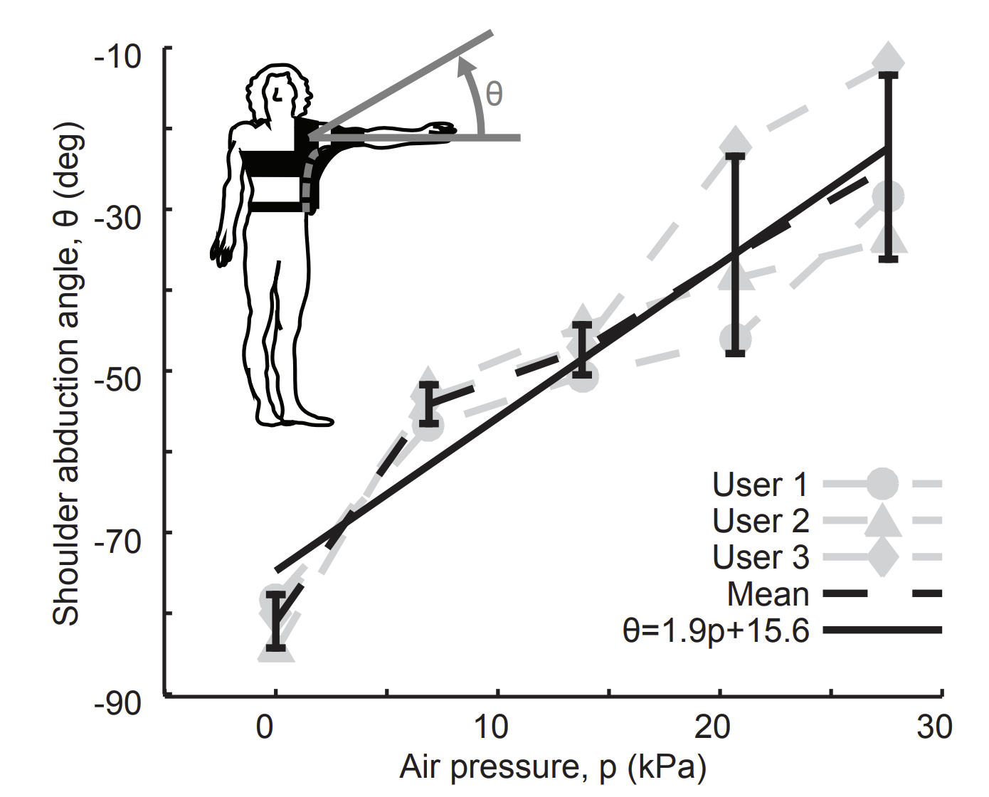
Stanford (ICRA 2017) [3]
Title: Exomuscle: An inflatable device for shoulder abduction support
Link
Description: Inflatable shoulder exoskeleton design and testing
Controller:
No information, seems to be hardcoded to go to required air pressure
Inflation time/speed:
Very little information, one note in discussion that “the portable compressor inflates the exomuscle beyond the maximum air pressure used in testing within three seconds” (note that testing max pressure was 27.5 kPa)
Out and back reaching test done for dynamic task compared to air bearing
Overall:
Clearly an early paper, follow up to see if more mature version has been published

Slide 13
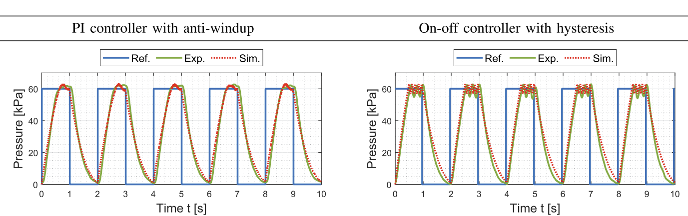
Newcastle (RAL 2021) [4]
Title: Design and Control of Pneumatic Systems for Soft Robotics: A Simulation Approach
Link
Description: Simulations of pneumatic exo control and testing of strategies on three soft actuators
Controller:
Compares two strategies: PI with anti-windup, On-Off with hysteresis
“PI controller provides smaller tracking error. The on-off controller has a faster rise time but larger pressure oscillation and larger constant tracking error”
Shows effect of different controllers and demonstrates that simulated results closely match
Overall:
Not tested on an actual exo, just pneumatic actuators

Slide 14
BioRobotics Institute Italy (TMRB 2025) [5]
Title: Preliminary Evaluation of a Soft Wearable Robot for Shoulder Movement Assistance
Link
Description: Testing pneumatic shoulder exo on patients with SCI. Analysis of range of motion and EMG.
Controller:
Bang-Bang with hysteresis and tolerance range of 3.5kPa
Ranges up to 77kPa
Target pressure manually set by researcher (70kPa used for experiments)
Results:
Slight drop in range of motion when wearing robot (healthy participants)
Muscle activation reduction much more clear in lift-and-hold tasks than in ROM tasks, particularly weighted lift-and-hold
Chronic patient more similar to healthy participants. Acute patient had little improvement in EMG but big improvement in ROM.
Inflation time/speed:
~5 seconds to inflate, 3.6 seconds to deflate for SCI patients between 0 and 70 kPa (no data on healthy)
Faster inflation for lighter patient, faster deflation for heavier patient

Slide 15
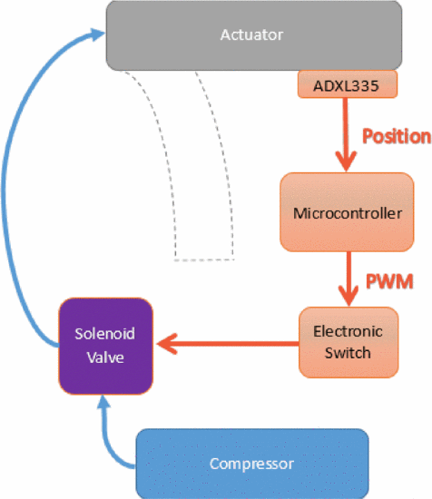
National University of Singapore (BioRob 2016) [6]
Title: Development of a soft robotic shoulder assistive device for shoulder abduction
Link
Description: Initial design and test of inflatable shoulder exoskeleton (tested only on mannequin and one subject)
Robot:
Actuator is on top of arm, and acts like a cantilever on shoulder as it inflates
Issues with buckling
Sewn into jacket, but issues with jacket dislodging
Control:
Tested angle (from accelerometer and motion capture) at intervals of 5kPa of pressure, up to 100kPa
Simple control diagram shown in Fig. 4, but not referenced in text (?)
Some position control testing
No information on inflation speed or higher level control

Slide 16
Technical University Darmstadt (Nature Scientific Reports 2021) [7]
Title: Soft pneumatic elbow exoskeleton reduces the muscle activity, metabolic cost and fatigue during holding and carrying of loads
Link
Description: Design and human testing of elbow pneumatic exosuit
Controller:
Tested only at constant elbow angle in isometric conditions -> not focused on control
“At this point, it is unclear what the optimal torque assistance profiles should look like for such dynamic movements, and how much users could benefit from sub-optimal assistance torques”
For testing, users positioned their elbow at the desired angle (only one angle tested), exo was then manually pressured to 1.3 bar (same for all subjects), and manually de-pressurized after the task
Results:
Decreases EMG activity during hold and carry tasks - larger decrease for longer holds + less weight (for same level of support)
Decrease in net metabolic rate, particularly for holding task
Inflation time/speed:
Without extra tank (air pump only), cycle time is ~15 seconds. With extra tank of pressurized air, cycle time ~2 seconds

Slide 17
REVIEW - National University of Singapore (TMRB, 2023) [8]
Title: Shoulder-Support Exoskeletons for Overhead Work: Current State, Challenges and Future Direction
Link
Description: Review of shoulder exoskeleton papers
Notes:
Of active actuators included in the review, 30% were pneumatic
Of active actuators included in the review, 72% used force/torque sensors for control and 18% used biomedical sensors
Almost all of the devices included have rigid structures
This paper seems to be unrelated to the above Singapore paper (no author overlap)
Control Suggestions:
EMG signals have not been sufficiently explored for exo control, particularly in conjunction with ML techniques for feature selection, to improve reliability
Admittance control (see AXO-SUIT) to help with problem of increased force needed to lower arm when exo is doing gravity compensation
“In pneumatically actuated devices, the control of the actuator output force is done by regulating the pressurized air pumped into the pneumatic actuator. However, the nonlinear force-displacement relationship of the pneumatic actuator has been shown to reduce control accuracy”
It is true that most of the above controllers (except the hand orthoses) try to reach a target pressure, not a target angle/position .. should we try to do angle?

Slide 18
REVIEW - ETH Zurich (Frontiers, 2022) [9]
Title: Intention detection strategies for robotic upper-limb orthoses: a scoping review considering usability, daily life application, and user evaluation
Link
Description: Review paper of intention/motion detection strategies for upper-limb exoskeletons (not limited to pneumatic)
Notes:
Most popular strategy for intention detection is EMG, followed by manual triggers (buttons, etc.) and force/movement generation
Strategies using IMU:
Directly decoding IMU signals into corresponding movement of the upper limb
Responding when IMU velocity exceeds given threshold (binary, only two states possible)
Responding to ‘shrug’ motion from the user (not intuitive - similar to shrug)
Strategies for EMG:
Response could be binary (muscle activation exceeds threshold) or proportional
Sensitive to sensor placement, sweat, muscle fatigue
Most papers used pattern recognition techniques
Using muscle activation allows for ‘prediction’ of motion, rather than estimation, because muscle react before moving
Other strategies:
eye tracking
MMG
Brain activity (EEG)
speech
manual triggers (button, joysticks, etc.)
Conclusions:
Bias towards objective metrics, but not much reporting on subjective metrics of user satisfaction
Lack of standardized benchmarks to compare between methods
Better to use methods/signals that are generated from intended movement (if possible - cannot use if subject is unable to move limb entirely) because these approaches are more intuitive

Slide 19
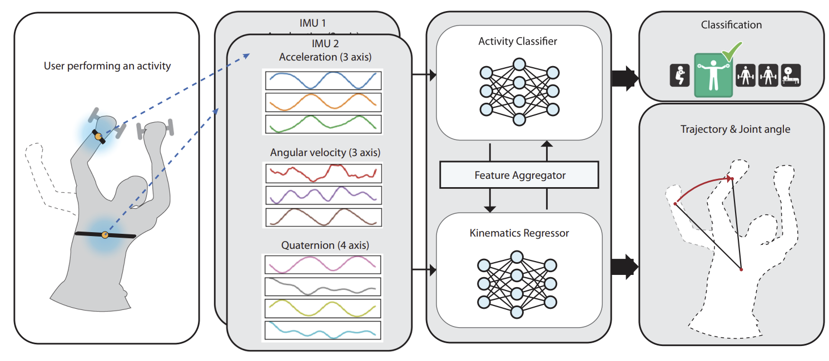
Harvard Intention Detection (Nature 2025) [10]
Learning-based 3D human kinematics estimation using behavioral constraints from activity classification
Link
IMU-based kinematics estimation using activity classification
Notes:
Not directly used on exo here
The second activity they test is shoulder angle estimation for assembly tasks, similar to our proposed use cases
For workout task: 2 IMUs worn by user, on chest and right wrist, for shoulder task: 3 IMUS, one on chest and one on each upper arm
Two neural networks: activity classification and kinematic regressor
Both stacked Dilated Convolutional Neural Networks (DCNNs)
Additional Feature Aggregation Network passes information between networks
In strength training, main improvement of this method (over LSTM or DCNN w/o activity classification) is at points where motion is changing (i.e. going from flex to extension or vice versa)
Activity classification very good for both task types
Networks not subject-specific
Error below 6.5° for shoulder actuation

Slide 20
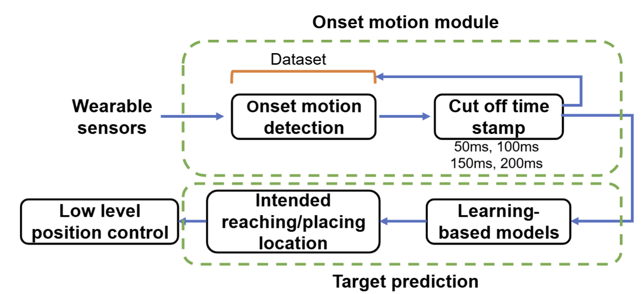
Nanyang Technological University (Sensors, 2023) [11]
Title: Learning-Based Motion-Intention Prediction for End-Point Control of Upper-Limb-Assistive Robots
Link
Description: Assessment of IMU, EMG, and MMG signals as input to several ML algorithms for position estimation during upper limb reaching task
Notes:
Several ML algorithms assessed to find best option: tree-based models (decision tree, adaboost, etc), support vector machine, feed-forward neural network (MLP), recurrent neural network (RNN), long short-term memory (LSTM) networks, and gated recurrent unit (GRU)
Best performance from LSTM and RNN
IMU alone is sufficient to predict the position
“The results show that using IMU sensor with the proposed prediction model is sufficient for motion intention detection, which can provide almost the same prediction performance compared with adding EMG or MMG.”
Looked at data windows of 50ms to 200ms - mixed results of which window is best
Users were able-bodied and not wearing exoskeletons during the task

Slide 21
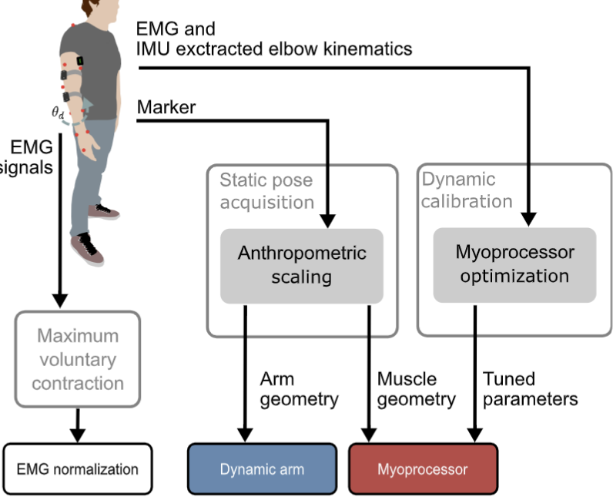
Heidelberg (TRO, 2022) [12]
Title: Myoelectric or Force Control? A Comparative Study on a Soft Arm Exosuit
Link
Description: Comparison of IMU vs. EMG based intention detection algorithms for soft elbow exo
Notes:
Comparison of EMG vs. IMU-based intention detection schemes for three tasks: step response, throw and catch, and pick and place
EMG controller typically responded faster, but IMU controller was more stable
For throw/catch task, EMG-based controller provides more assistance (better able to handle this dynamic task)
For pick and place task, IMU-based controller provides more support for user
IMU-based controller is based on dynamic equations using inertial matrix, coriolis force and gravity

Slide 22
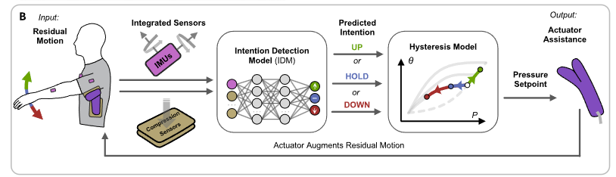
Harvard 3 (Nature Communications, 2023) [13]
Title: Personalized ML-based wearable robot control improves impaired arm function
Link
Description: Simple NN controller for pneumatic actuator tested on subjects with ALS and stroke.
Notes:
Control
Inputs: 3 IMU sensors (for unilateral assistance) and 3 compression sensors (for helping with hysteresis)
Network: Fully connected NN with 2 hidden layers. Categorical output of UP, DOWN or HOLD. If UP or DOWN, tell controller to adjust angle by 5 degrees.
Model based hysteresis model (future work - can we incorporate this into the NN?)
Training/Testing
9 subjects, including 5 stroke survivors and 4 ALS patients
Model was trained with ~17 minutes of data per participant. Model was individually trained for each subject, but tested on a different day than training (interday reliability). While training HOLD condition, participants were instructed to move elbow and wrist (while keeping shoulder constant) to improve results when doing other tasks.
Hysteresis model was also personalized to the participant.
Also tested in homes of participants doing ADL for two subjects
Limitations & Opportunities for Improvements
Too many sensors. They used 3 IMUS and 3 compression sensors. We would ideally use 2 IMU sensors only to reduce setup time/cost/complexity.
Their NN is very simple. It has only 2 hidden layers and all layers are fully connected. A more sophisticated network should be able to improve on these results.
They use a model-based approach for the hysteresis to convert between up/down/hold outputs from the NN and desired pressure. We could instead do an end-to-end model that directly outputs the desired pressure.
They have to train the model separately for each individual and input the limb lengths/weights for the hysteresis model. Their model cannot adapt if the user picks up an object (thus changing the weight of the arm). Our plan is to make a more adaptable model that is continuously updating so it can adjust to changes in the user in real time.
Their model is categorical, it can only output UP, DOWN or HOLD, and the UP and DOWN outputs result in changes in angle of a step size of 5 degrees. This is not truly continuous as we plan for our model to be.

Slide 23
Harvard 3 (Nature Communications, 2023) [13]
Title: Personalized ML-based wearable robot control improves impaired arm function
Link
Description: Simple NN controller for pneumatic actuator tested on subjects with ALS and stroke.
Notes:
Limitations:
-
-
-
Improvements:
-
-
-
Josephine Odusanya

Slide 24
Harvard 3 (Nature Communications, 2023) [13]
Title: Personalized ML-based wearable robot control improves impaired arm function
Link
Description: Simple NN controller for pneumatic actuator tested on subjects with ALS and stroke.
Notes:
Limitations:
-
-
-
Improvements:
-
-
-
Josephine Odusanya

Slide 25
Harvard 3 (Nature Communications, 2023) [13]
Title: Personalized ML-based wearable robot control improves impaired arm function
Link
Description: Simple NN controller for pneumatic actuator tested on subjects with ALS and stroke.
Notes:
Limitations:
-
-
-
Improvements:
-
-
-
Josephine Odusanya

Slide 26
Madrid (IEEE Access, 2023)
Accuracy comparison of CNN, LSTM, and transformer for activity recognition using IMU and visual markers
Link
Description: Comparison between IMU and marker-based motion capture for intention detection/activity recognition. Different ML methods are tested (including CNN/LSTM/transformers)
Notes:
Study only looking at activity classification, not position estimation
Did feature selection with random forests to determine feature importance score, then added features (most to least important) until training stopped improving
Hand accelerometers were most important features in IMU sets
60Hz sampling was sufficient for task classification
Best architectures: 2LConv 93.8%, 2LConv+BiLSTM 92.3%, Conv+LSTM 90%
Visual marker sometimes outperformed IMU, but have significant downsides for practicality (can’t handle occlusion, privacy concerns for camera, longer set up time)

Slide 27
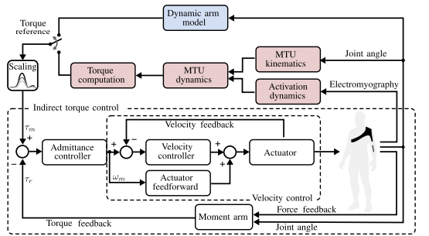
Heidelberg II (BioRob 2020)
Intention-detection strategies for upper limb exosuits: Model-based myoelectric vs dynamic-based control
Link
Description: Comparison between two intention detection strategies for an elbow exo: (1) model-based myocontroller and (2) dynamics-based gravity compensation
Notes:
Considered both unloaded condition and 1.5kg weight condition for flexion and extension
Position tracking (user tracking desired angle with their elbow angle) was not improved with the exoskeleton for either controller
Muscle activations were converted to torques using model of upper arm muscles
Two controller performed very similarly (no statistical significance mentioned but seems the same)
Exoskeleton (both controllers) generally decreased EMG levels
Triceps activation increased with controller (possibly due to user misestimated bicep assistive force and compensating)
Very small sample size (n=4)

Slide 28
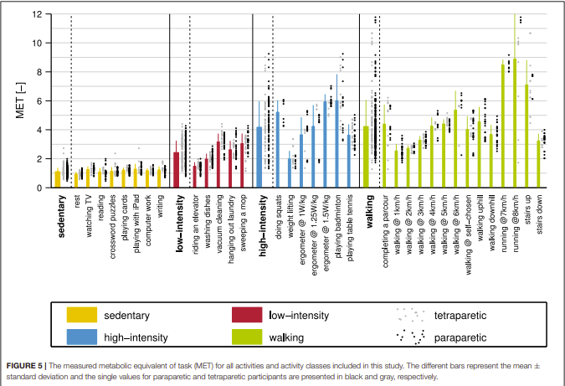
ETH (Frontiers, 2019) - SCI Exercise
Wearable Sensors in Ambulatory Individuals With a Spinal Cord Injury: From Energy Expenditure Estimation to Activity Recommendations
Link
Description: Adapting exercise recommendations for users with SCI that are still ambulatory
Notes:
Determined that 10000 steps a day recommendation for able bodied individuals is equivalent to 8000 for SCI patients
Used metabolic rate to determine intensity of exercise
Useful list of activities of daily living - consider these as tasks for future work with SCI patients
Classed as sedentary, low-intensity, high-intensity and walking
See also methods for how to work with SCI patients

Slide 29
References
Zhou, Y. M., Hohimer, C. J., Young, H. T., McCann, C. M., Pont-Esteban, D., Civici, U. S., ... & Walsh, C. J. (2024). A portable inflatable soft wearable robot to assist the shoulder during industrial work. Science Robotics, 9(91), eadi2377.
Zhao, H., Jalving, J., Huang, R., Knepper, R., Ruina, A., & Shepherd, R. (2016). A helping hand: Soft orthosis with integrated optical strain sensors and EMG control. IEEE Robotics & Automation Magazine, 23(3), 55-64.
Simpson, C. S., Okamura, A. M., & Hawkes, E. W. (2017, May). Exomuscle: An inflatable device for shoulder abduction support. In 2017 IEEE International Conference on Robotics and Automation (ICRA) (pp. 6651-6657). IEEE.
Xavier, M. S., Fleming, A. J., & Yong, Y. K. (2021). Design and control of pneumatic systems for soft robotics: A simulation approach. IEEE Robotics and Automation Letters, 6(3), 5800-5807.
Campioni, L., Dimonte, G., Sciarrone, G., Righi, G., Walsh, C., Gandolla, M., ... & Proietti, T. (2025). Preliminary Evaluation of a Soft Wearable Robot for Shoulder Movement Assistance. IEEE Transactions on Medical Robotics and Bionics.
Natividad, R. F., & Yeow, C. H. (2016, June). Development of a soft robotic shoulder assistive device for shoulder abduction. In 2016 6th IEEE International Conference on Biomedical Robotics and Biomechatronics (BioRob) (pp. 989-993). IEEE.
Nassour, J., Zhao, G., & Grimmer, M. (2021). Soft pneumatic elbow exoskeleton reduces the muscle activity, metabolic cost and fatigue during holding and carrying of loads. Scientific Reports, 11(1), 12556.
Reyes, F. A., Shuo, D., & Yu, H. (2023). Shoulder-support exoskeletons for overhead work: Current state, challenges and future directions. IEEE Transactions on Medical Robotics and Bionics, 5(3), 516-527.
Gantenbein, J., Dittli, J., Meyer, J. T., Gassert, R., & Lambercy, O. (2022). Intention detection strategies for robotic upper-limb orthoses: a scoping review considering usability, daily life application, and user evaluation. Frontiers in neurorobotics, 16, 815693.
Kim, D., Jin, Y., Cho, H., Jones, T., Zhou, Y. M., Fadaie, A., ... & Walsh, C. J. (2025). Learning-based 3D human kinematics estimation using behavioral constraints from activity classification. Nature Communications, 16(1), 3454.
Yang, S., Garg, N. P., Gao, R., Yuan, M., Noronha, B., Ang, W. T., & Accoto, D. (2023). Learning-based motion-intention prediction for end-point control of upper-limb-assistive robots. Sensors, 23(6), 2998.
Lotti, N., Xiloyannis, M., Missiroli, F., Bokranz, C., Chiaradia, D., Frisoli, A., ... & Masia, L. (2022). Myoelectric or force control? A comparative study on a soft arm exosuit. IEEE Transactions on Robotics, 38(3), 1363-1379.

Slide 30
Meeting with Prof. Su - Notes
Date: May 29, 2025
Lit Review Format/Overall Notes:
2-3 slides on SOTA - include quadrants or line to show where different papers lie
Break into motion detection and torque profile generation
Ideally want to design end to end controller
Try to identify problems with cable exo as well
Ideally identify controller/solution for pneumo that is applicable to cable exo as well
In slides, include Control Blocks (Talk to Antonio): Planning -> Low Level Control
Get NMPC code + state estimation from IMU from Ludo
Re: Angle control idea: Don’t call it position control, continuous control is better
Areas to include in lit review/project idea generation:
Motion/Intention Detection
Look into transformer - Haoran SWIM
See manifold in Rutgers
Frontiers (Switzerland)
ludo state estimation
Torque profile generation
nMPC
gravity comp
RL
Low level control for pneumatics - force control
Continuous control RAM paper Cornell Zhao
How to make faster/less noisy
End to End Control (via learning in sim)
Ludo already has simulator
Nature paper
Drone nature paper from U Zurich Davide Sacamora

